Slide 2

Design and Implement a Motion Detection Based IoT System to Optimize Power Consumption Year (2023-24)
Supervisor: Dr. M.V. Deepak Nair
Assistant Professor, ECE Department
The LNMIIT Jaipur
Presented By: Kartik Khandelwal Viren Sharma
Roll No.: 21UEC071 & 21UEC143

Slide 3
Outline:
Introduction and Literature Survey
Goals of BTP
Flow Chart
Experimental Setup
Results and Observation
Timeline and Future Goals
References

Slide 4
Introduction and Literature Survey:
Occupancy Sensor Effectiveness: Research in smart homes demonstrates the effectiveness of occupancy sensors in optimizing energy consumption. Studies like N. Thaleeparambil (2024) showcase their ability to detect presence and adjust appliance usage accordingly [1].
Market Trend: The growth of the smart appliance market, highlighted by market research [2], indicates a consumer interest in intelligent and energy-efficient devices.
Integration Potential: Studies like T. Blank (2021) exploring intelligent control systems for appliances via the internet [3] further emphasize the potential for integrating IoT technology into traditional appliances.
Goals of BTP:
To design and implement a network of Radar based IoT nodes for motion detection and power optimization for classrooms and corporate board meeting rooms.
Deploy multiple detection nodes strategically within the room to achieve robust motion detection, comprehensive coverage and share power consumption to users distributed in a hierarchal way.

Slide 5
Importance of Motion Detection in IoT:
Enhanced Security
Energy Conservation
Data-Driven Insights
Optimized User Experience
Healthcare Monitoring

Slide 6
Architecture:

Slide 7
Flow Chart
Not
Detected
Node Power
ON
Movement Detected ?
Connecting To Network
Not
Connected
Connected Successfully ?
Detected
Turn ON Electrical Device
Turn Node ON from Node-Red Dashboard
Wait For 10 seconds
(Adjustable Wait Time)

Slide 8
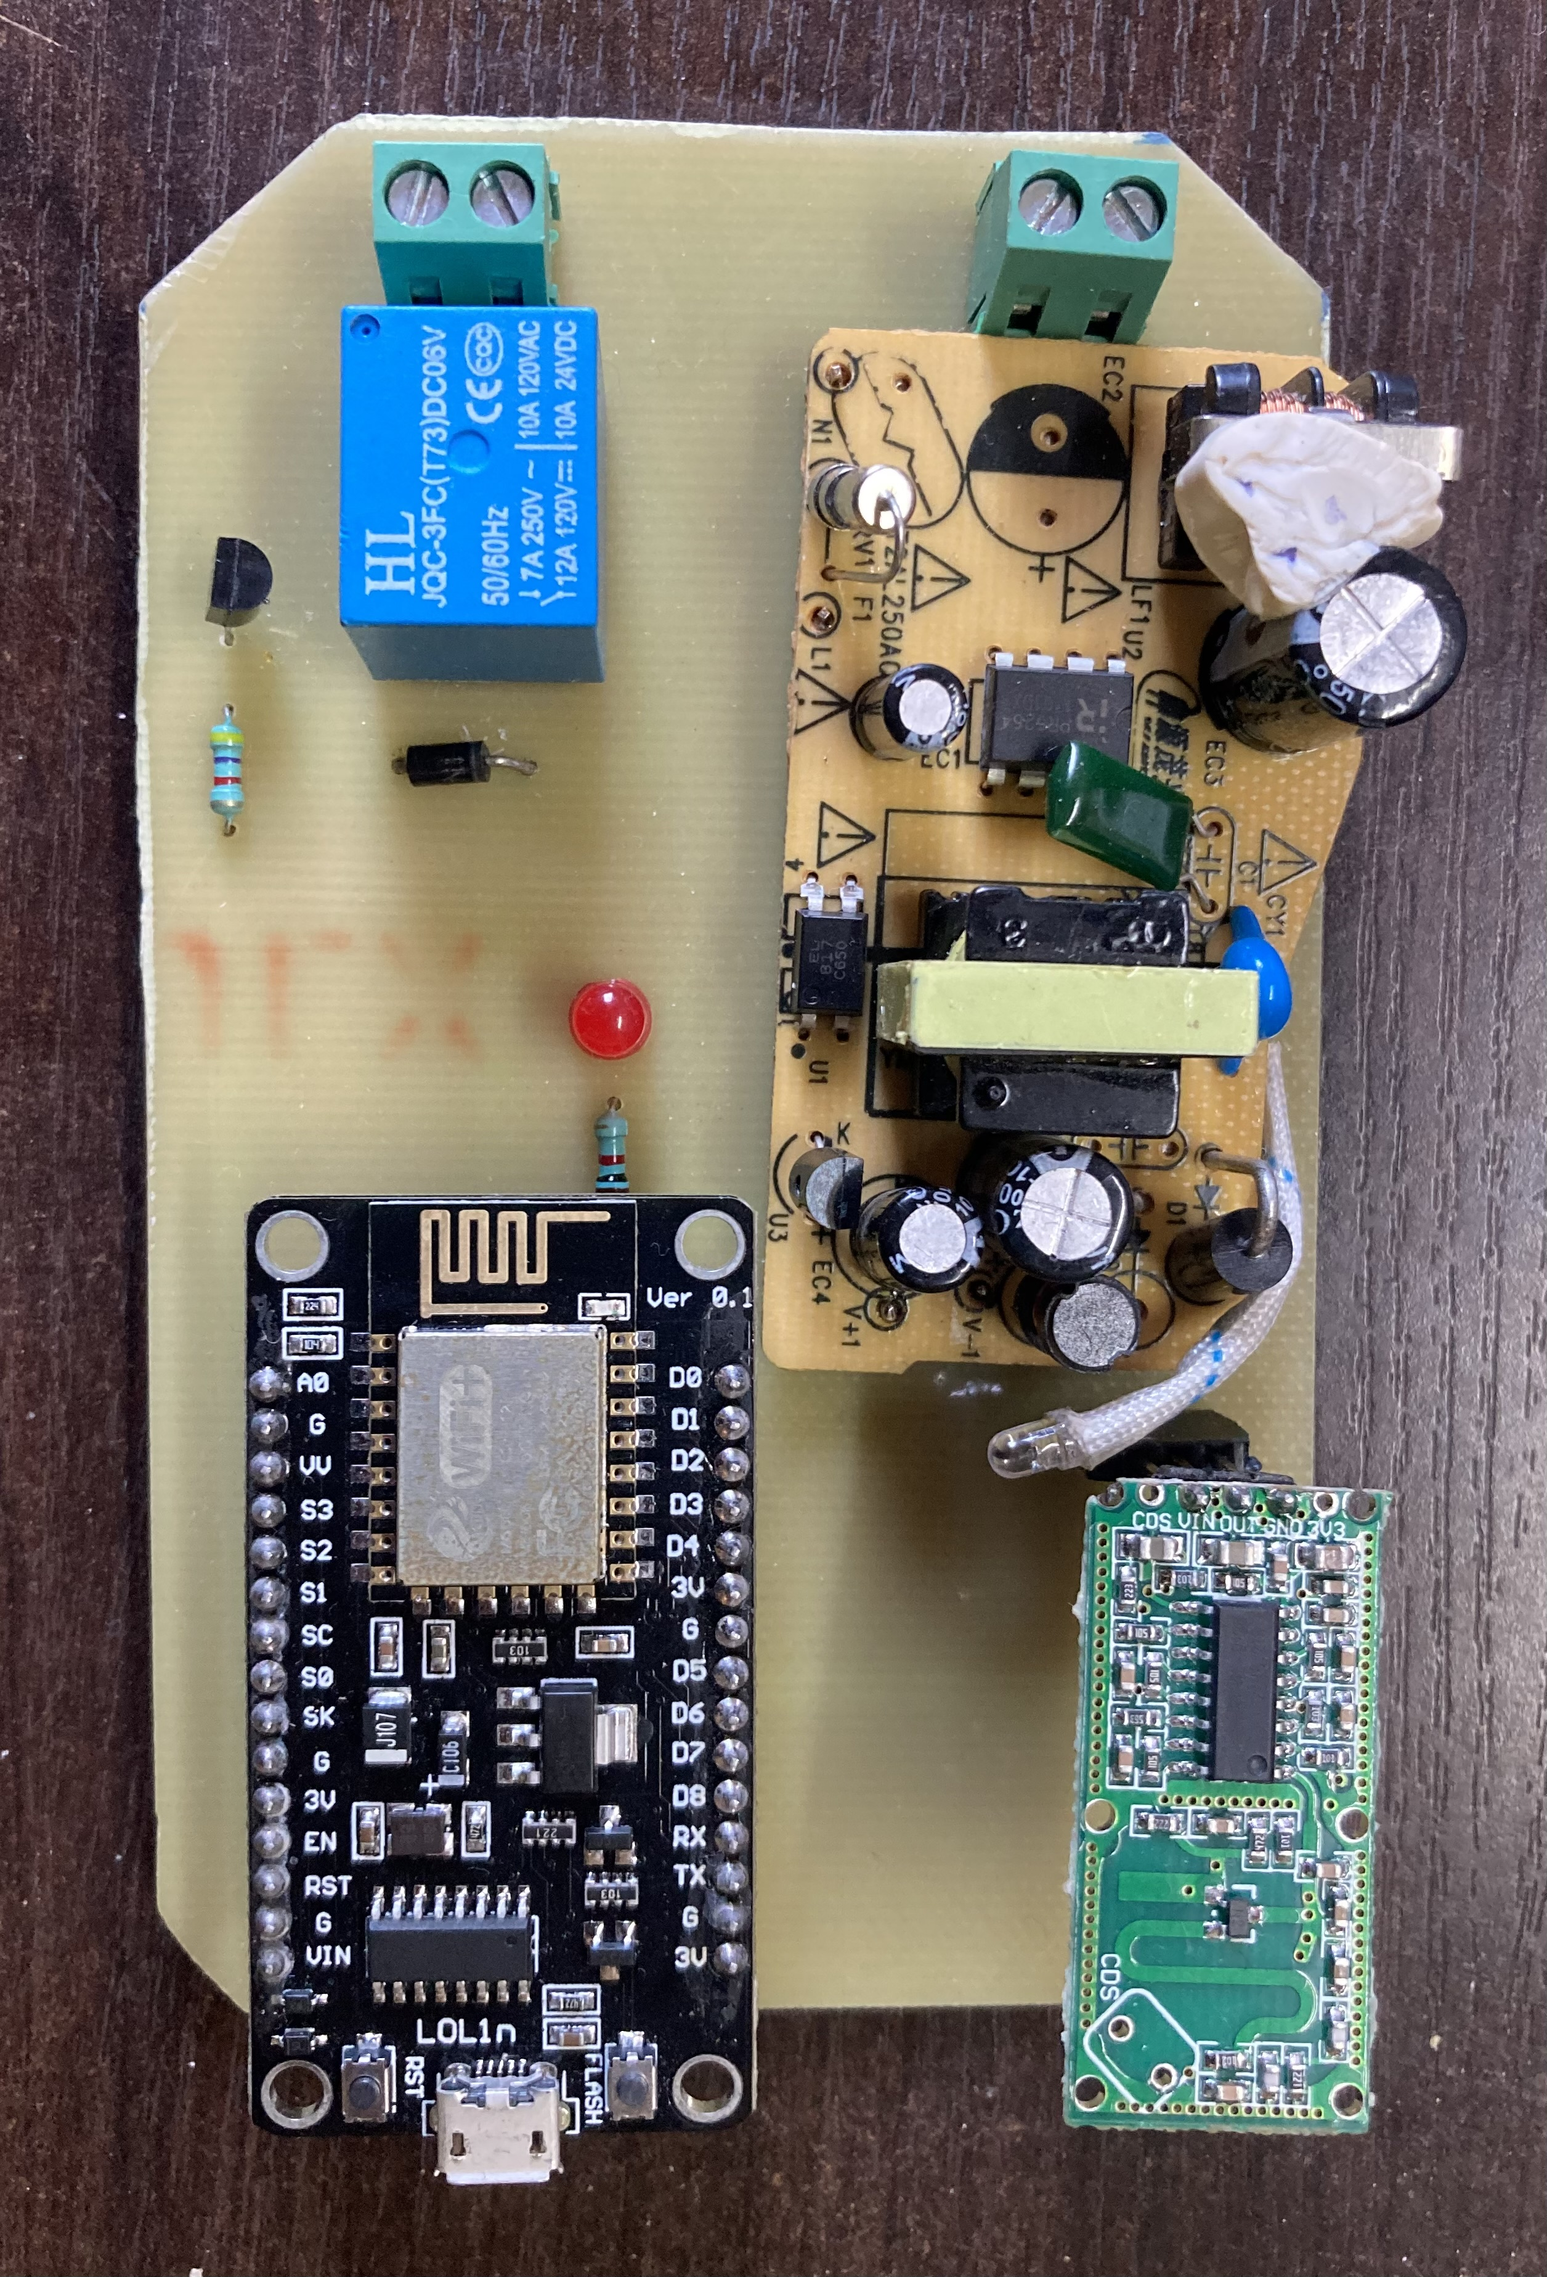
Experimental Setup:
4
3
A Single Sensor Node Consists:
NodeMCU Module(ESP-12E)
RCWL Radar Module for detection
Electrical Relay
AC to DC Switching Mode Power Supply (SMPS)
1
2
Motion Detection Node

Slide 9
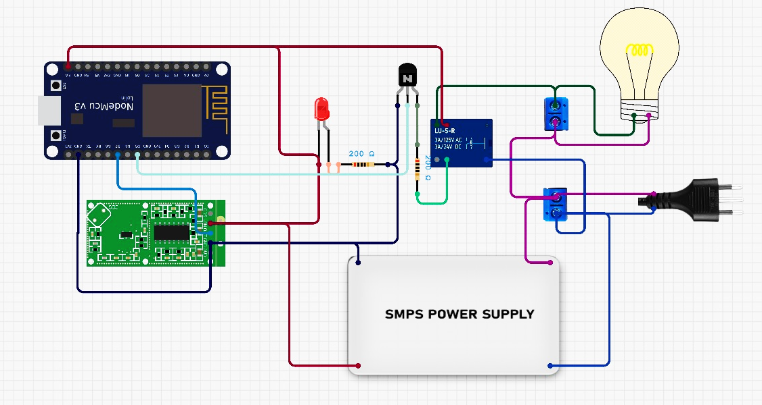
Circuit Design:
Graphical Circuit Representation of Motion Detection Node

Slide 10
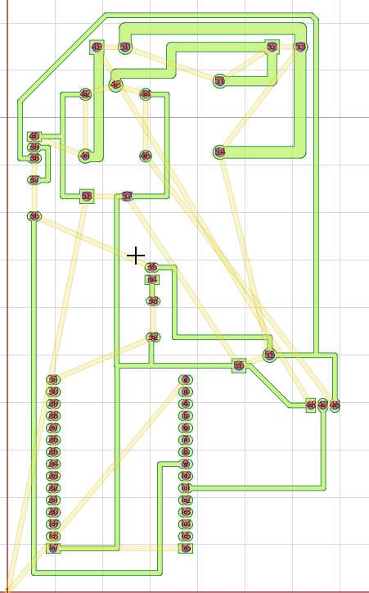
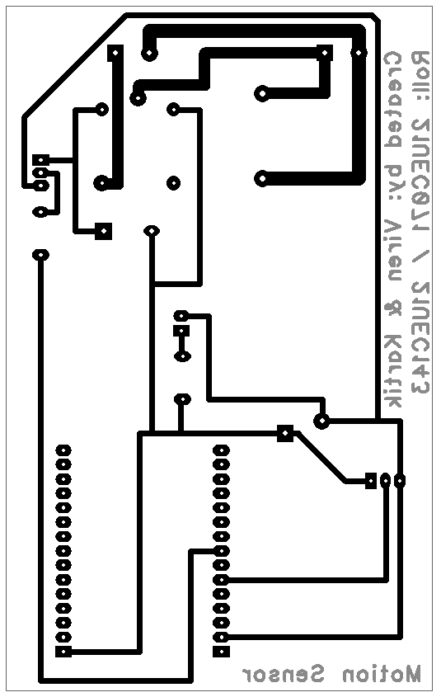
PCB Diptrace Design:
Diptrace PCB Design
FlatCAM PCB Gerber File

Slide 11
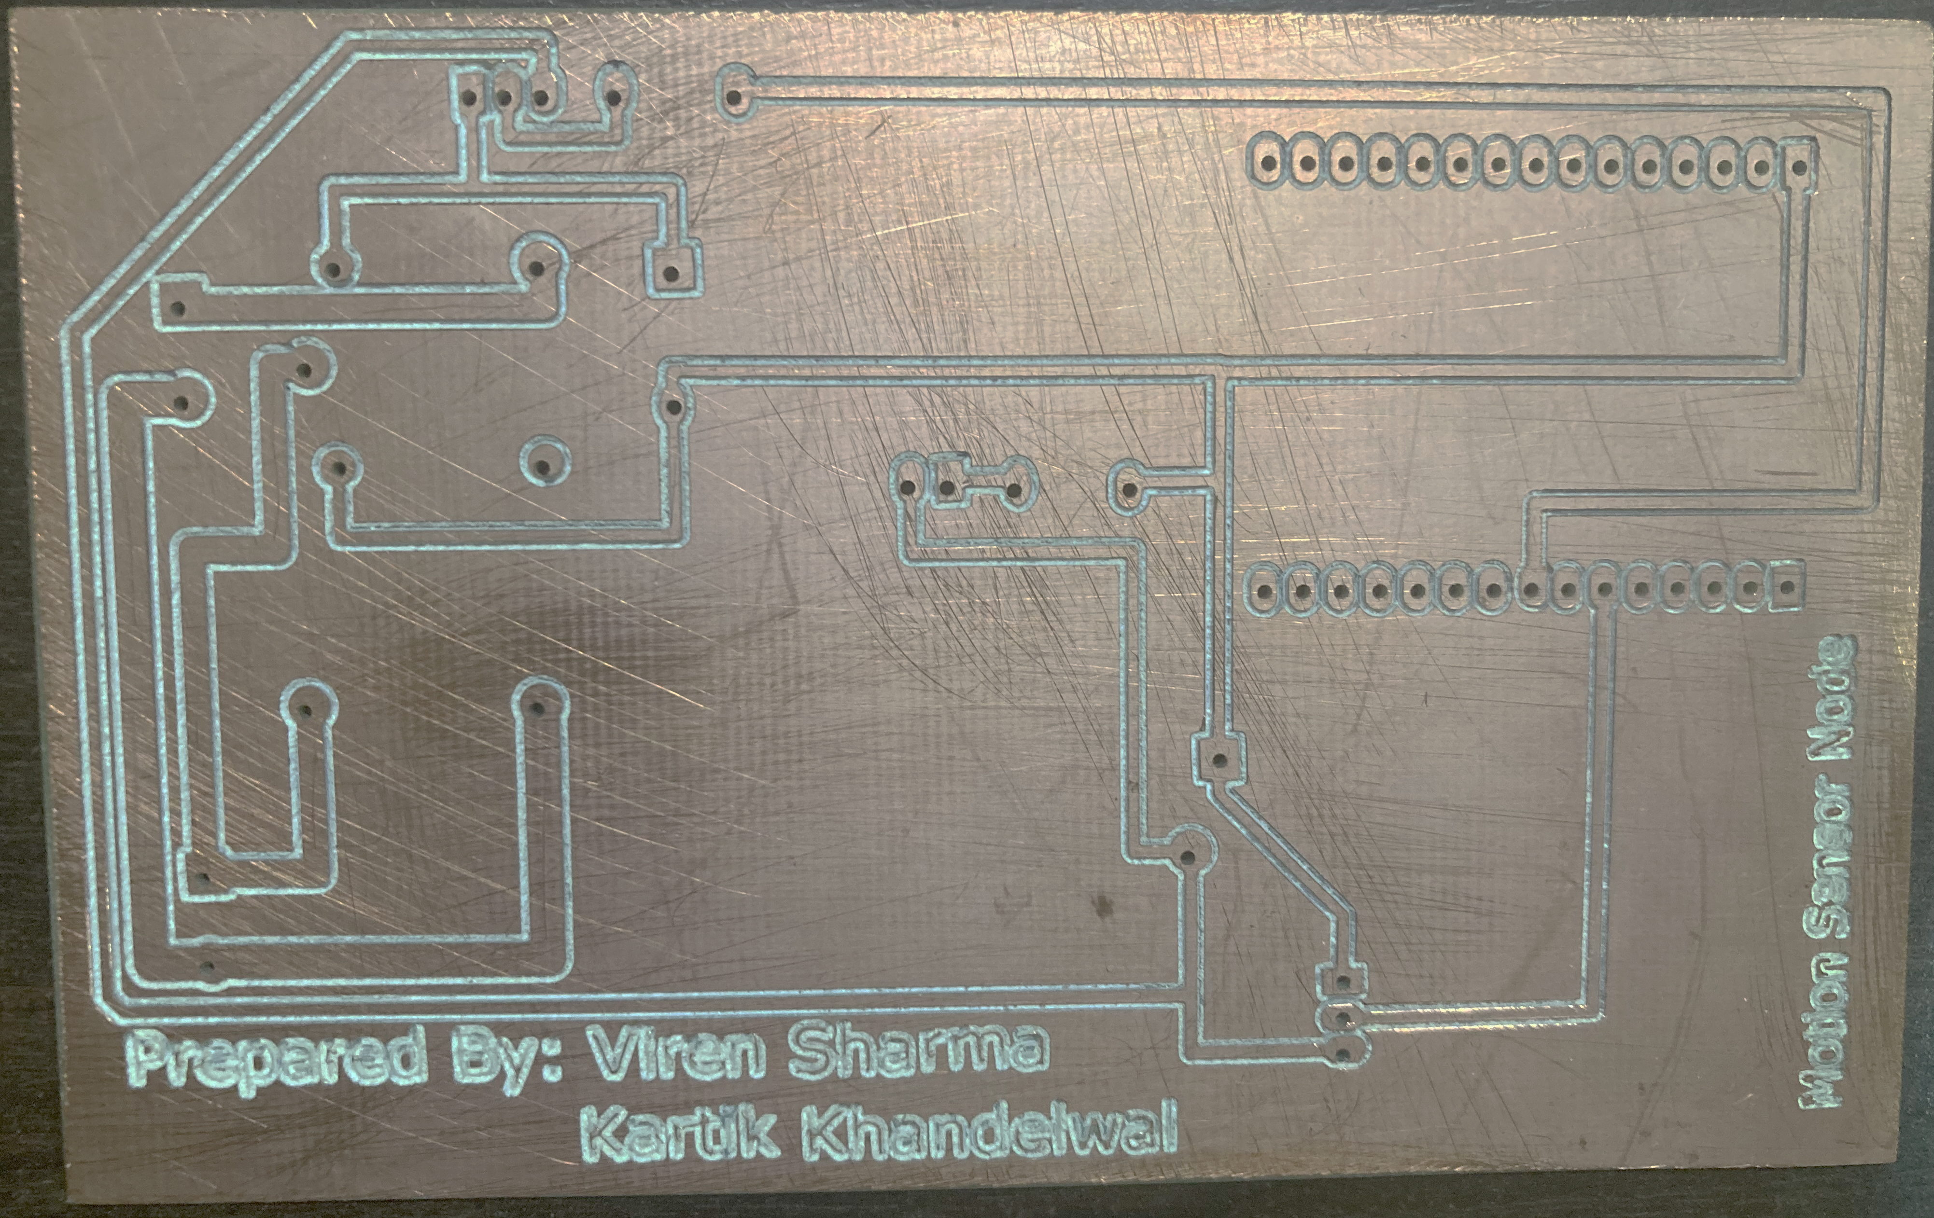
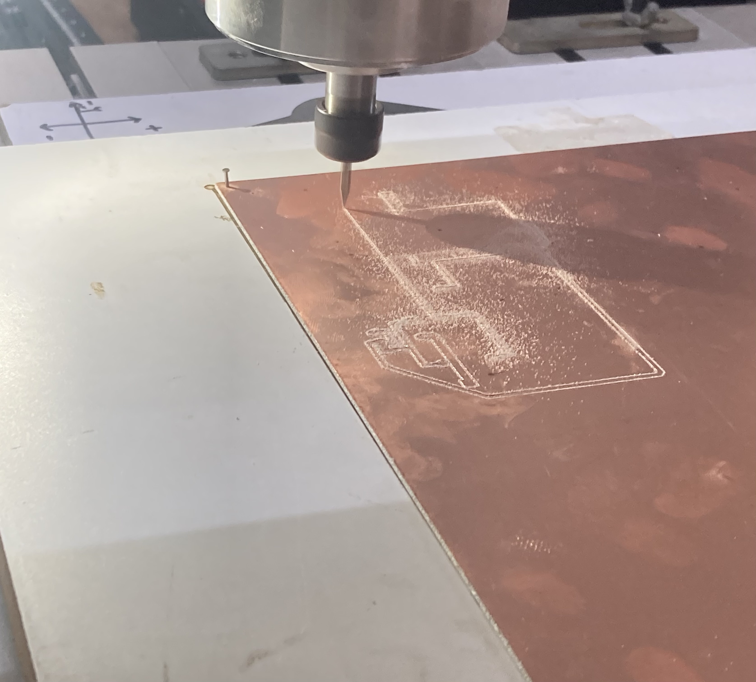
CNC Machine Printing:
PCB printing using CNC Machine
First PCB Printed

Slide 12
Circuit Testing:
Short Circuit Testing:
Visual Inspection: Check for signs of shorts like solder bridges, debris, or damaged traces.
Continuity Testing: Use a multimeter to identify unintended connections between points on the PCB.
Functional Testing: Powering on the PCB and monitoring for abnormal behavior after integration of all components.
EMI/EMC Testing:
Near-field Probe: A near-field probe is used with the RSA306B Spectrum Analyzer to measure electromagnetic fields close to the PCB or its components.
Real-time DPX spectrum allows us to detect emissions not visible in a standard swept spectrum display.
EM Fields generated by relay, antenna on NodeMCU and RCWL module measured.

Slide 13
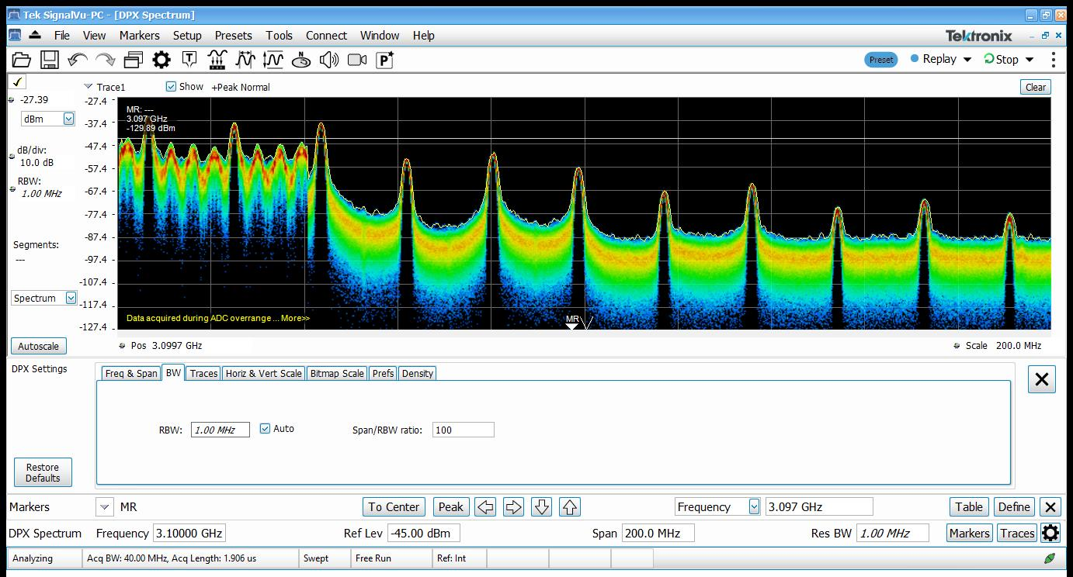
EMI/EMC compliance measurement setup
Power(dBm) vs Frequency (GHz) for RCWL-0516

Slide 14
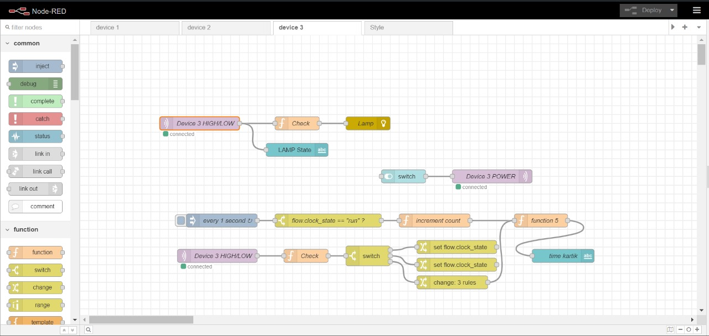
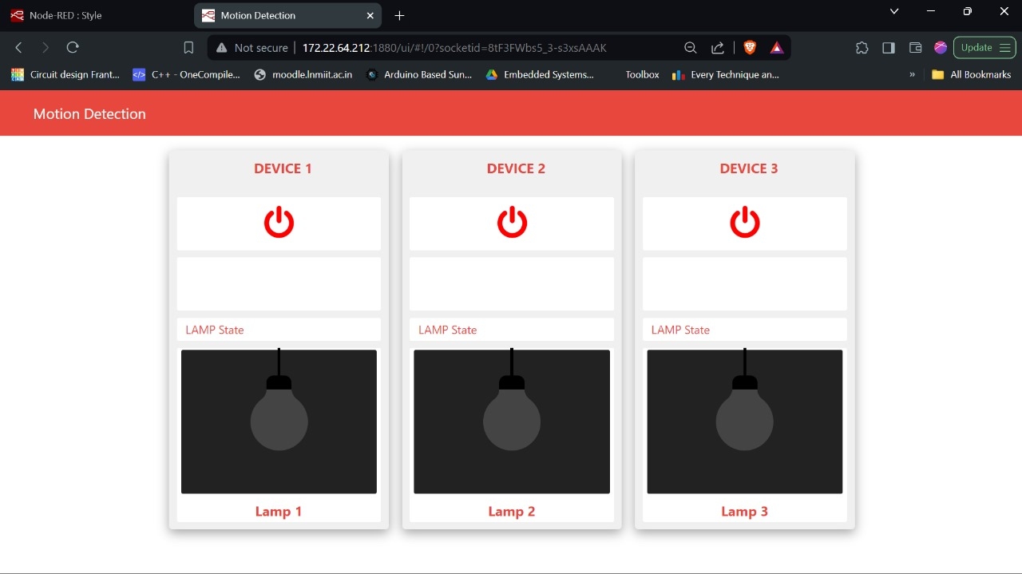
Software Application:
Utilizing Arduino IDE for NodeMCU programming and Node-RED flows for IoT interfacing.
Node-RED Flow
Application Dashboard

Slide 15
MQTT Architecture

Slide 16
Observations:
Electrical relay generates harmonics of different frequencies affecting the proper functioning of the RCWL radar module.
RCWL radar module generates EM waves around 3.18 GHz.
Wi-Fi Router does not affect the functioning of RCWL.
Diagonal placement of RCWL and relay at a distance of 7.5 to 8.0cm reduces the number of false triggers significantly.
Transformer-less power supply designed earlier had high heat dissipation, requiring the integration of high-wattage resistors. Additionally, the limited output current prompted us to shift to SMPS.
Only devices with network credentials that precisely match those of the node are permitted to establish a connection with the Mosquitto broker.

Slide 17
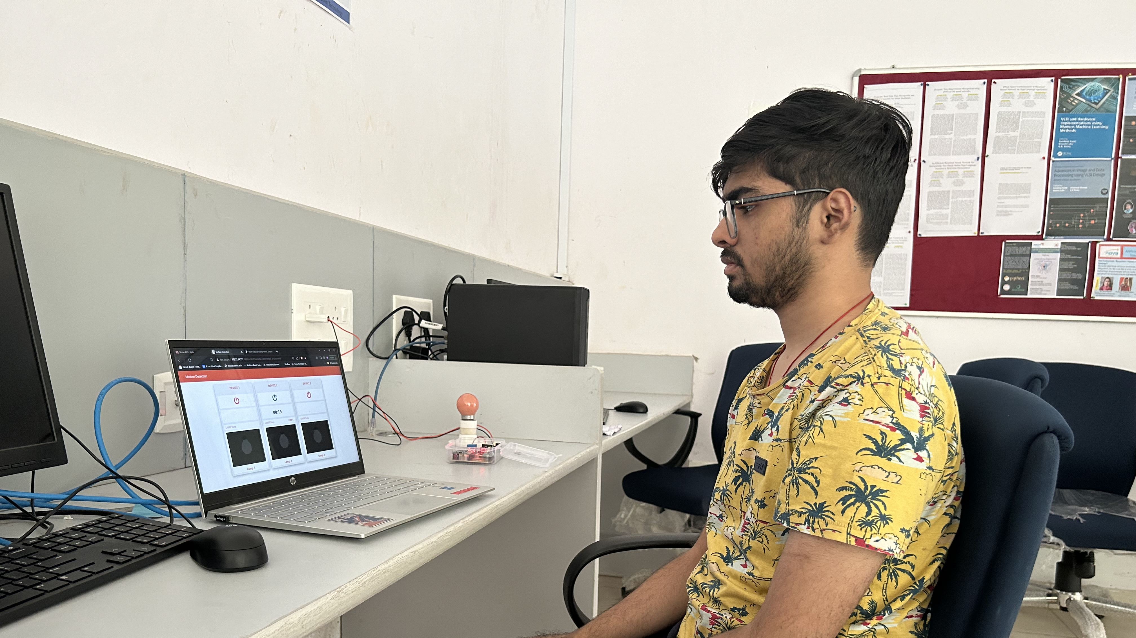
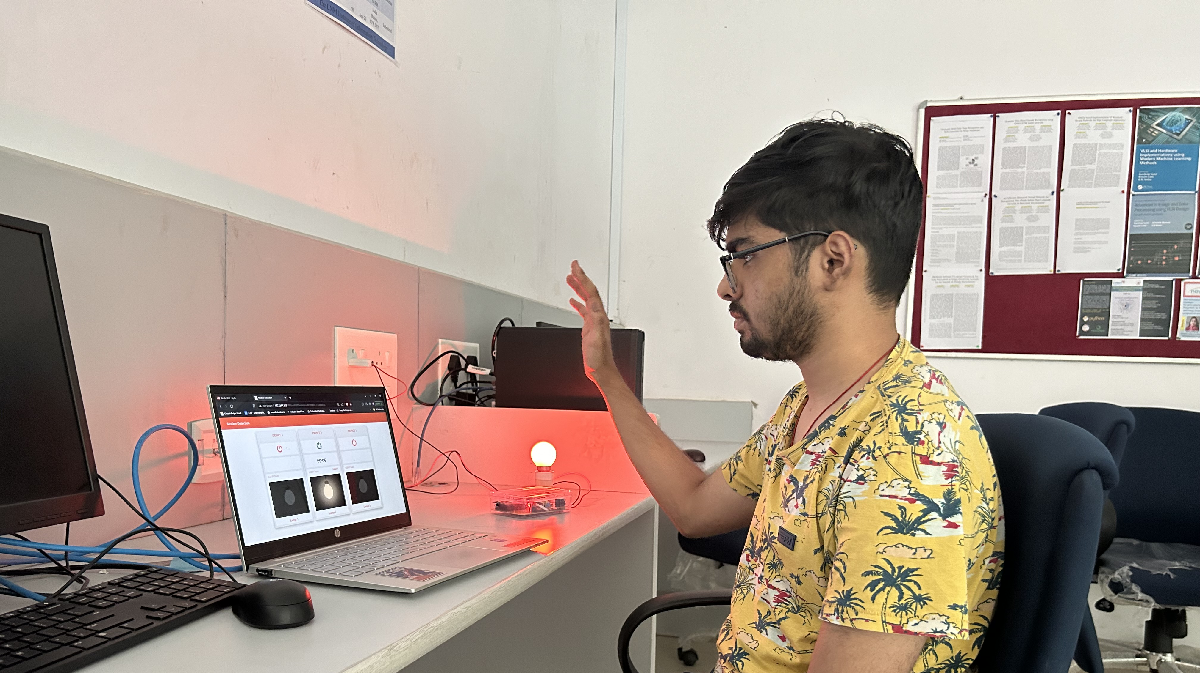
Results:
No Movement
Movement Detected

Slide 18
Learning/Outcomes:
Working of Switching Mode Power Supply.
Functioning of RCWL radar module and its calibration to change the sensitivity range.
Prototyping using Zero PCB.
DipTrace designs PCBs and generates Gerber, board, and drill files, which are then converted to G-Code using FlatCAM for CNC machining.
Power measurement using DMM7510 7 ½ digital Multimeter.
Short Circuit Testing and EMI/EMC Testing using RSA306B Spectrum Analyzer.
Node-RED Flow Programming and interfacing with IoT systems.
Working of MQTT protocol.

Slide 19
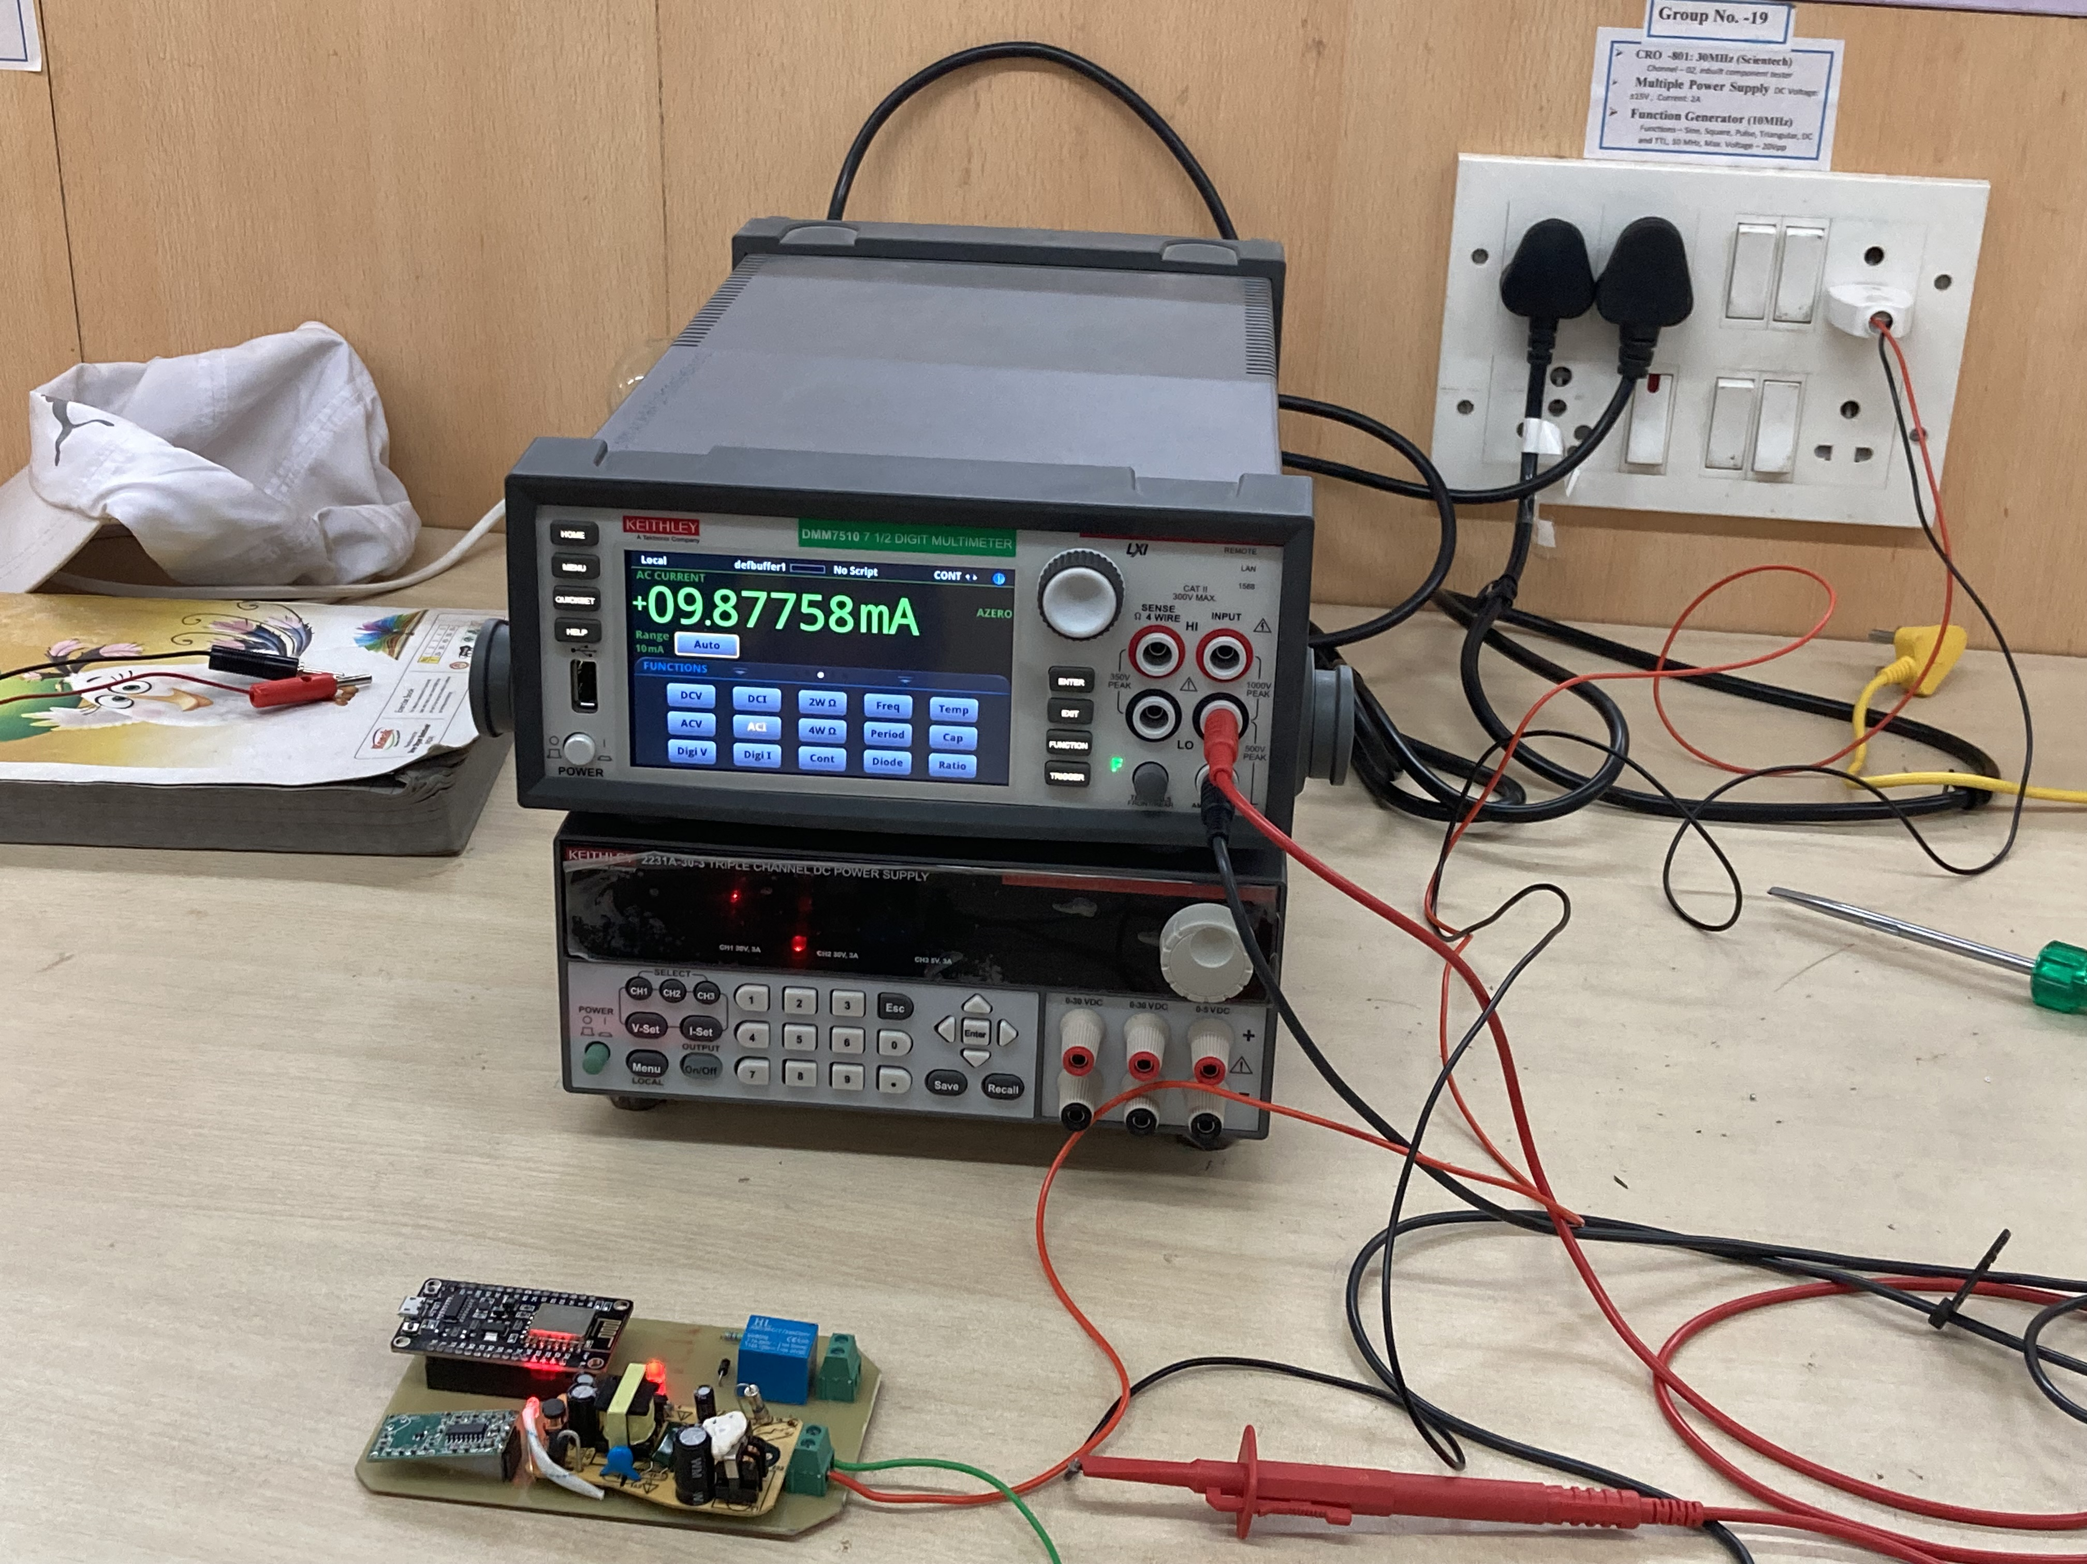
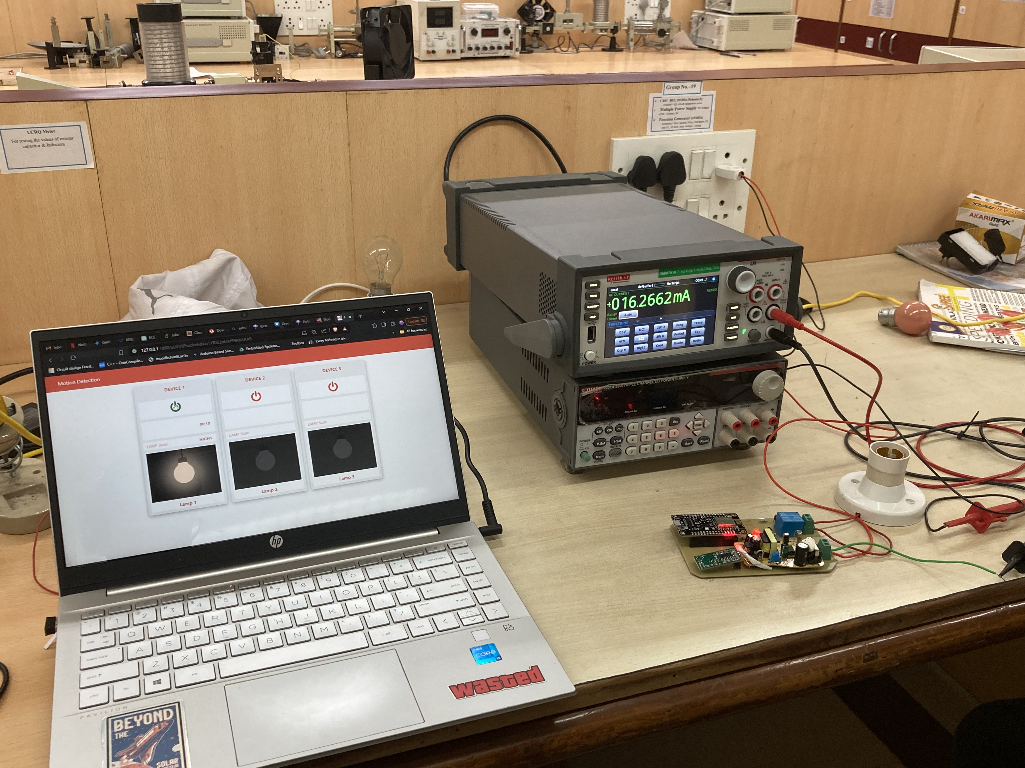
Power Consumption Measurement Setup:
Without Triggering
With Triggering
Idle Power Consumption=2.17W
Dynamic Power Consumption=3.57W

Slide 20
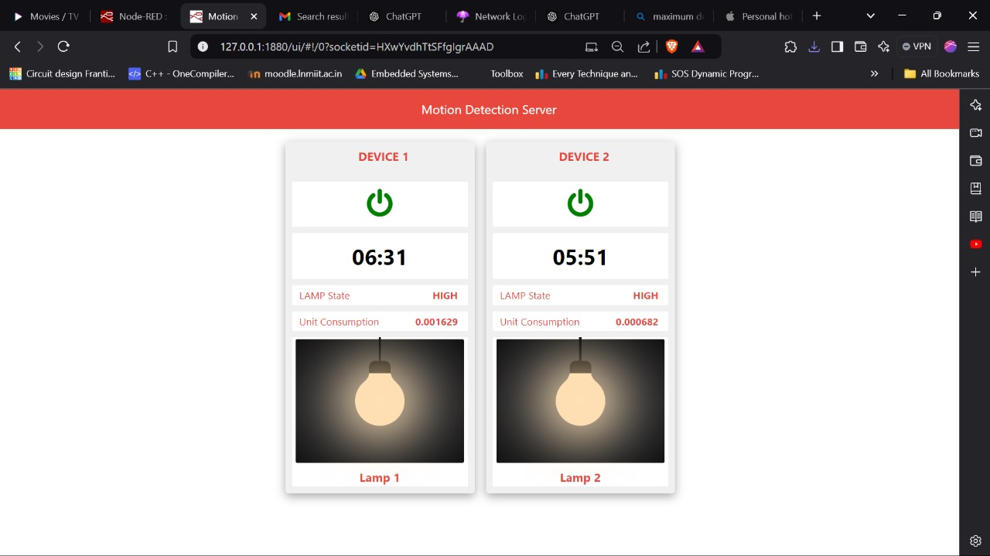
Updated Node-RED Dashboard:

Slide 21
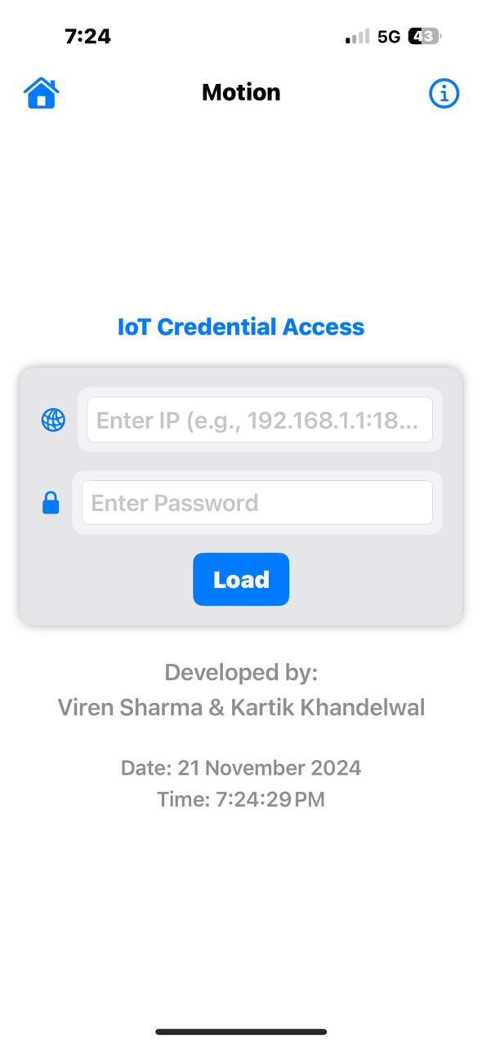
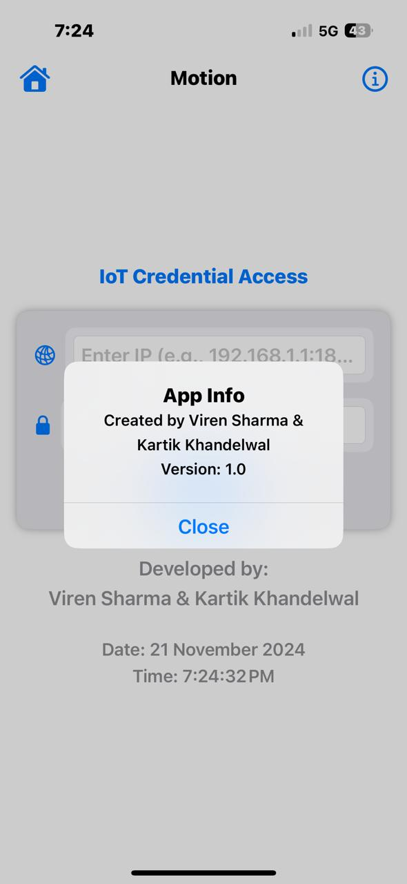
Motion IOS Application:

Slide 22
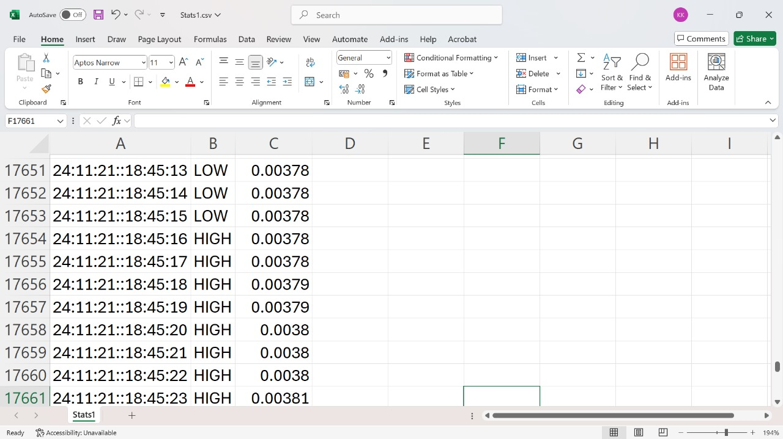
Data published in Excel:

Slide 23
Timeline Pre-Mid Term
RCWL Testing using 2nd Prototype
Zero PCB prototyping
15th January 2024
24th February 2024
20th March 2024
26th January 2024
9th March 2024
Literature Survey, Goal Setting
1st Prototype using Arduino
SMPS Integration on Zero PCB
Development of basic Switching Algorithm

Slide 24
Timeline Post-Mid Term
EMI/EMC Testing
Real environment testing with H/W and S/W calibration
10th August 2024
20th September 2024
15th November 2024
30th August 2024
10th October 2024
PCB Printing using CNC
Setting up Node-RED with MQTT
Introduction of live energy tracking and adaptive timers

Slide 25
Conclusion:
The proposed system comprises 3 radar sensor IoT nodes for HAR (Human Activity Recognition).
Each sensor has an aperture field area of 30.58 m², with a human detection accuracy of 95.6%.
Different nodes have varied wait times ranging from 10 seconds to 40 seconds.
Each sensor node has been tested for approximately 200-300 readings in real-world settings such as labs.
Idle Power Consumption = 2.17W and Dynamic Power Consumption=3.57W
The system's accuracy remains consistent across different wait times, demonstrating its potential to adapt without compromising on detection performance.

Slide 26
Future Goals :
To enhance the reliability of the RCWL module and minimize false triggers by utilizing RF shielding.
To develop a power optimization algorithm and integrate power consumption analytics to optimize energy usage.
To design and implement a comprehensive database for logging lighting system data within a room.
To implement SMS notifications advising occupants to relocate for energy conservation purposes.
To include enhanced security algorithms for the complete network.
Conference Paper accepted in IEEE ICPC2T 2025

Slide 27
References:
[1] N. Thaleeparambil, A. Biju and B. Prathap, "Integrated Automated Attendance System with RFID, Wi-Fi, and Visual Recognition Technology for Enhanced Classroom Security and Precise Monitoring," 2024 IEEE International Conference on Contemporary Computing and Communications (InC4), Bangalore, India, 2024.
[2] Grand View Research. (2024). Global Smart Lighting Market Size, Share & Trends Analysis Report By Product (LED Lighting, OLED Lighting), By Application (Indoor Lighting, Outdoor Lighting), By Region, And Segment Forecasts, 2023-2030.
[3] J. A. L. Marques et al., "IoT-Based Smart Health System for Ambulatory Maternal and Fetal Monitoring," in IEEE Internet of Things Journal.
[4] T. Blank et al., "Non-Imaging Digital CMOS-SOI-MEMS Uncooled Passive Infra-Red Sensing Systems," in IEEE Sensors Journal.

Slide 28
Design and Implement a Motion Detection Based IoT System to Optimize Power Consumption Year (2023-24)
Thank you
and
Queries Please…
Supervisor: Dr. M.V. Deepak Nair
Assistant Professor, ECE Department
The LNMIIT Jaipur
Presented By: Kartik Khandelwal Viren Sharma
Roll No.: 21UEC071 & 21UEC143

Slide 29
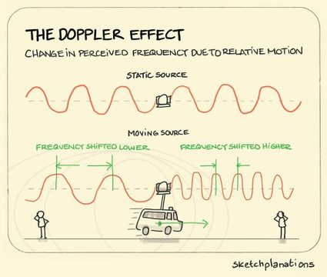
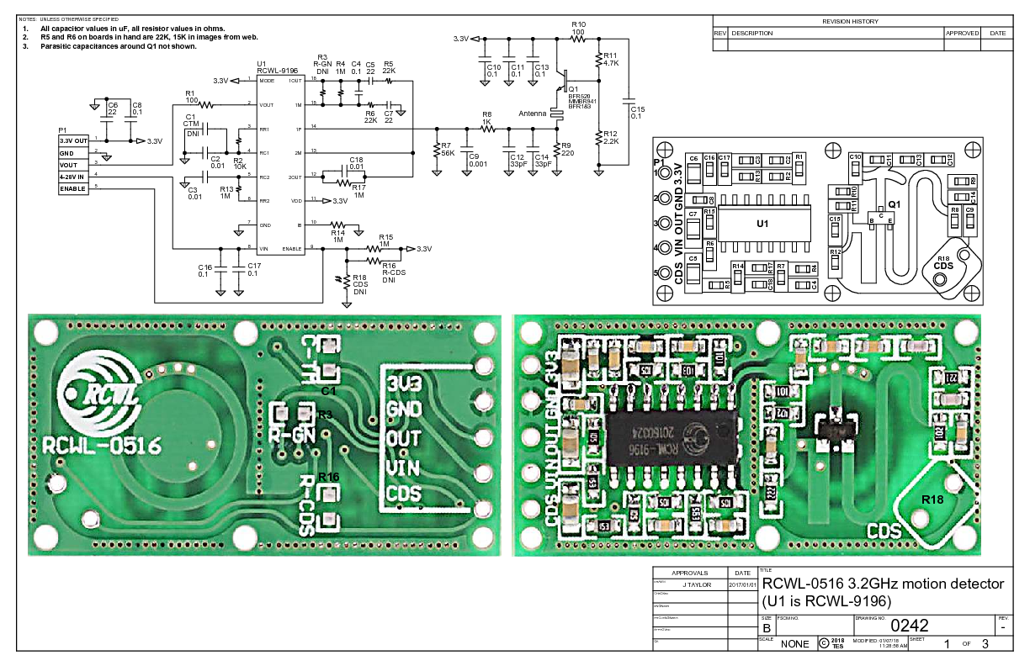
RCWL Radar Module’s Working and Features
RCWL Module: Microwave radar motion sensor module
Operates on Doppler effect principle.
Emits signals around 3.18 GHz frequency omnidirectionally.
Circuit comprises of a microwave transceiver, mixer and a lower frequency section with RCWL-9196 IC.
Observed Working Range: 4-5 meters.

Slide 30
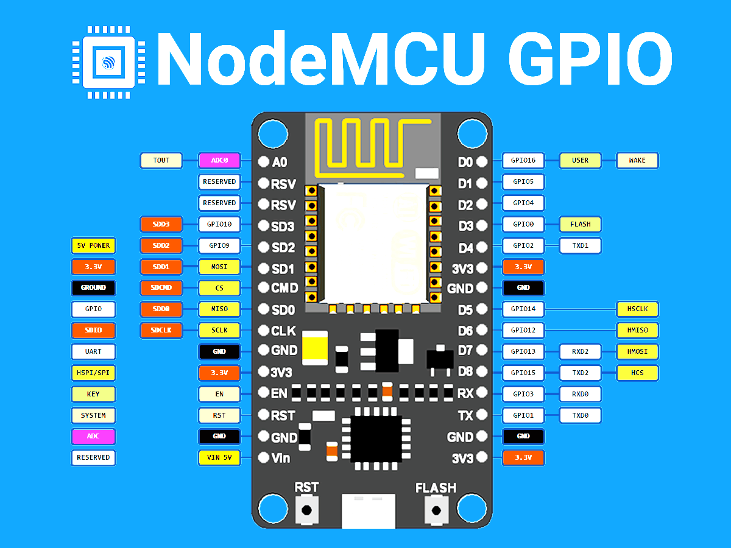
NodeMCU Module:
Open-source firmware and development kit for IoT prototyping.
ESP-12E: Low-cost Wi-Fi microchip with TCP/IP stack and microcontroller capability.
GPIO Pins: NodeMCU offers 17 GPIO pins (11 usable) and PWM support (at a time on 6 pins).
Communication Interfaces: Supports UART, SDIO, SPI, I2C and IR remote control.
Wi-Fi Connectivity: Operates at 2.4 GHz with WPA/WPA2 support for secure connections.
NodeMCU Pinout

Slide 31
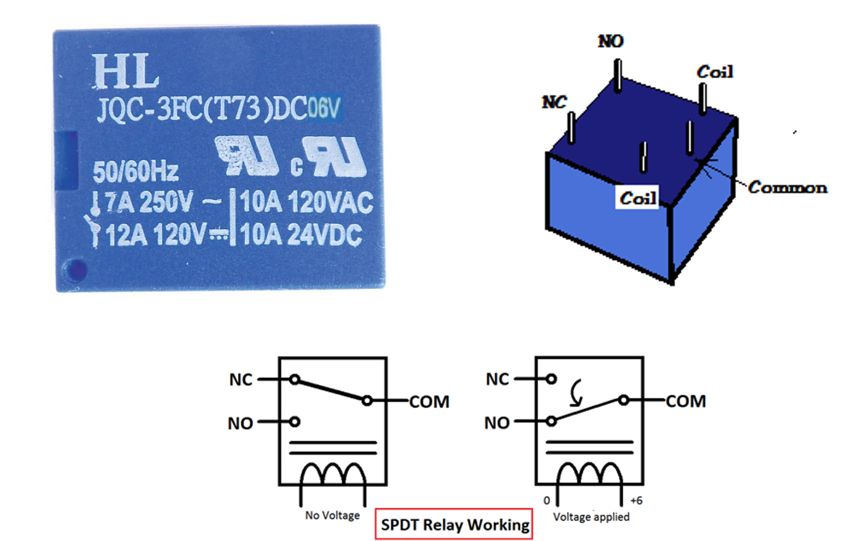
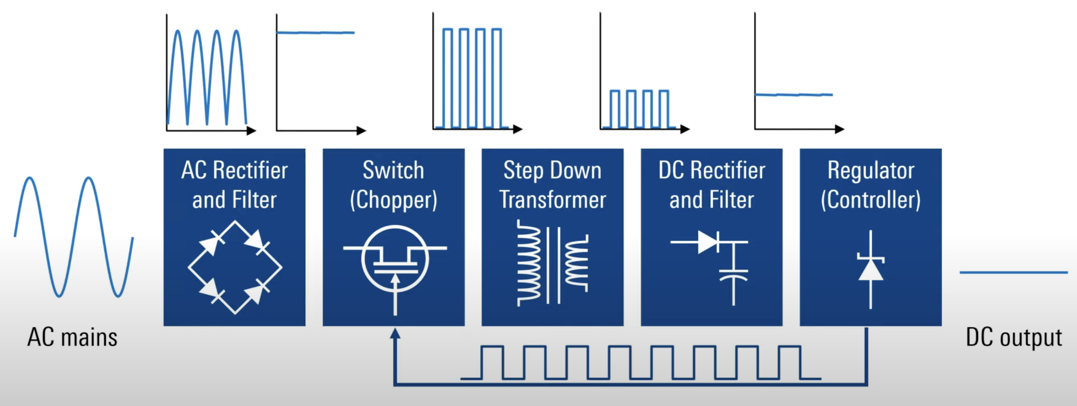
Electrical Relay and AC-DC SMPS
SPDT relays switch between two circuits with one common terminal and two others (Normally Open and Normally Closed).
When energized, the common terminal connects to Normally Open; when not, it connects to Normally Closed.
SMPS efficiently convert AC to DC through rapid voltage switching.
SMPS provide stable voltage output for consistent power.
Smaller size of transformer coils.

Slide 32
Motion Detection Sensor Modules Comparison Table
Feature | RCWL-0516 Microwave Radar Sensor | PIR Sensor | Ultrasonic Sensor
Detection Method | Microwave Radar(3.18GHz) (Doppler Effect) | Passive Infrared (PIR) | Ultrasonic Waves (30–500 kHz)
Detection Range | 5-7 m | 10-12 m | 2-4 m
Detection Area | Omnidirectional | Limited | Limited
Environmental affect | Less affected by temperature and humidity | Sensitive to temperature and humidity [4] | Affected by temperature and humidity
Advantages of RCWL-0516 - |  | High sensitivity and accuracy Less affected by environmental factors Low susceptibility to false alarms Omnidirectional detection

Slide 33
Why NodeMCU?
Feature | NodeMCU (ESP8266) | ESP32
CPU | Tensilica Xtensa LX106 | Dual-core Tensilica Xtensa LX6
CPU Frequency | Up to 160 MHz (SW limited to 80MHz) | Up to 240 MHz (single-core) Up to 160 MHz (dual-core)
Wi-Fi Connectivity | Built-in | Built-in
ADC | 10-bit | 12-bit
GPIO | 17 GPIO Pins | 34 GPIO Pins
Approx. Cost | ₹160-170 | ₹390-400

Slide 34
RCWL-0516 EMI/EMC Testing using RSA306B Spectrum Analyzer

Slide 35
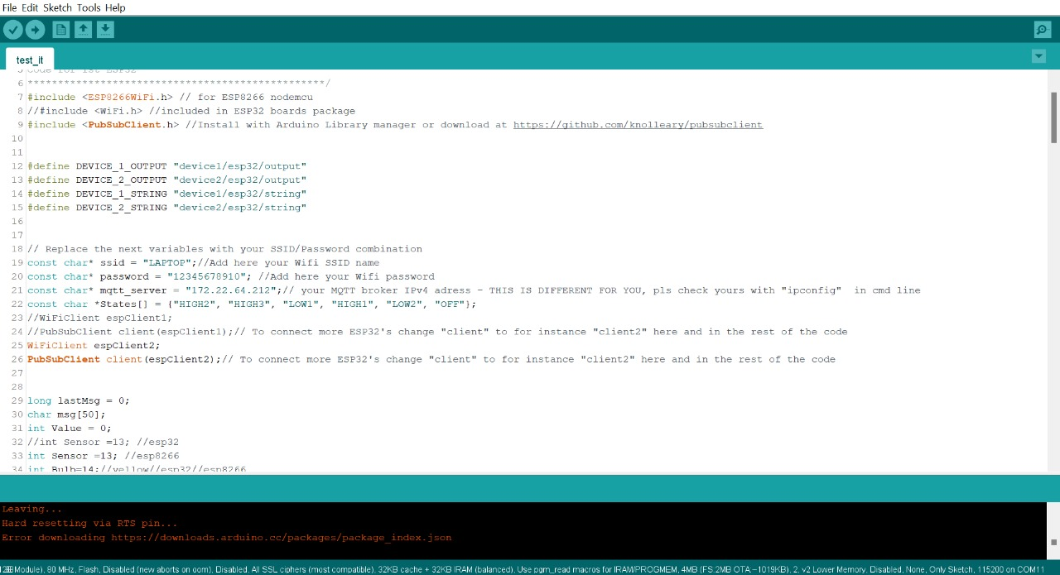
Arduino Code Snippet

Slide 36
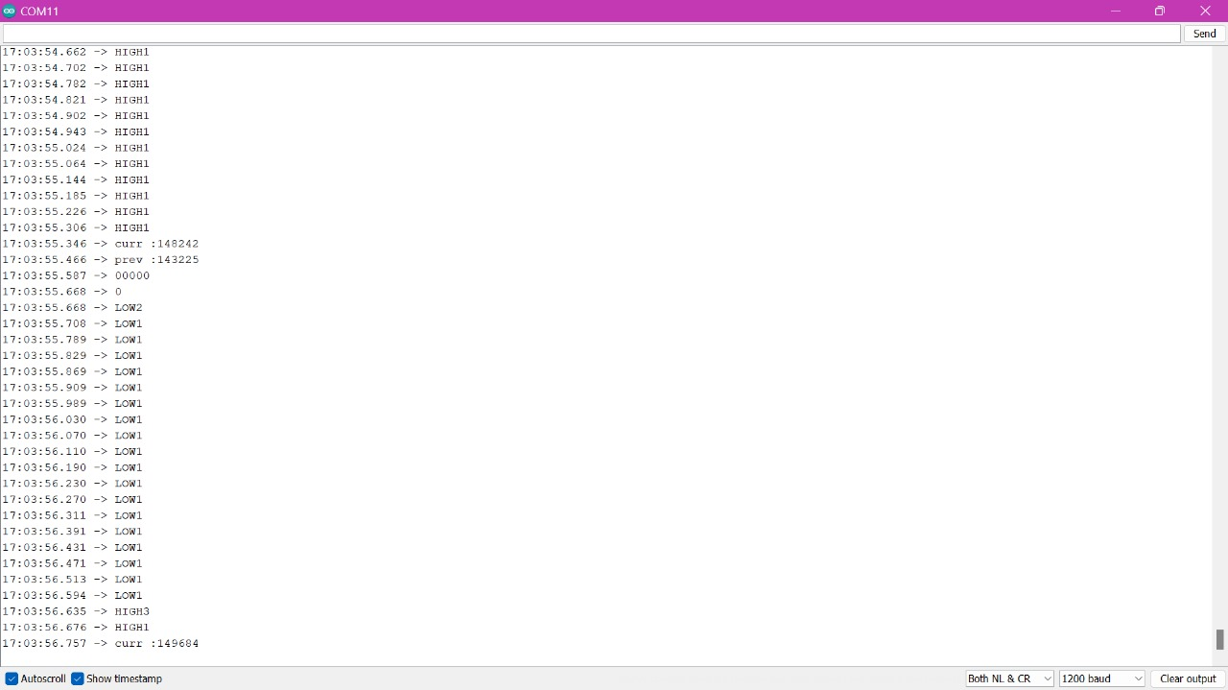
Serial Monitor Status

Slide 37
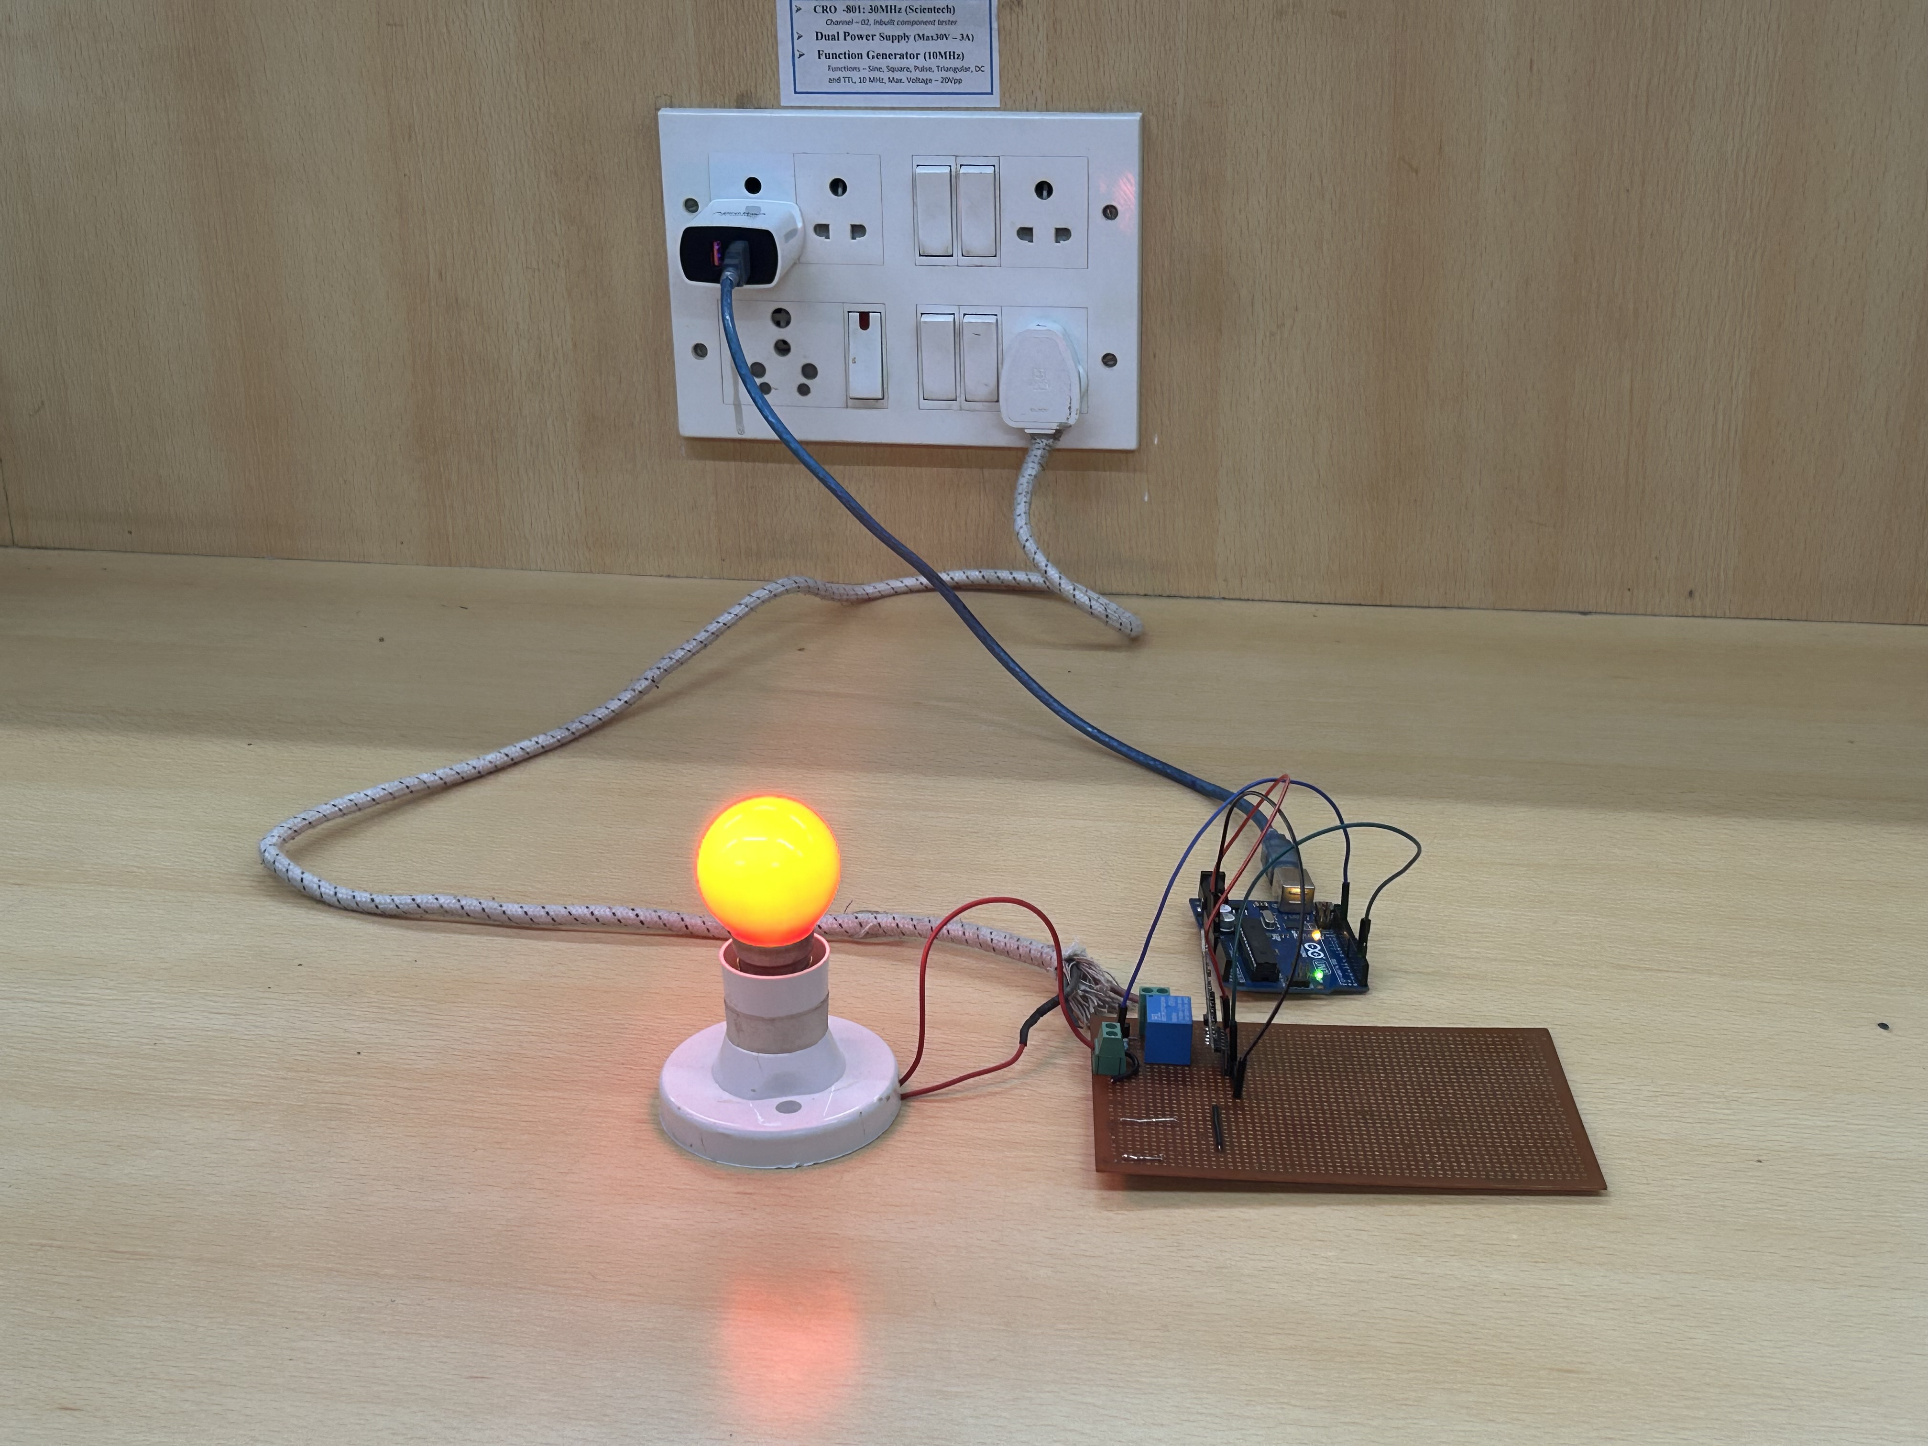
1st Prototype-15/01/24

Slide 38
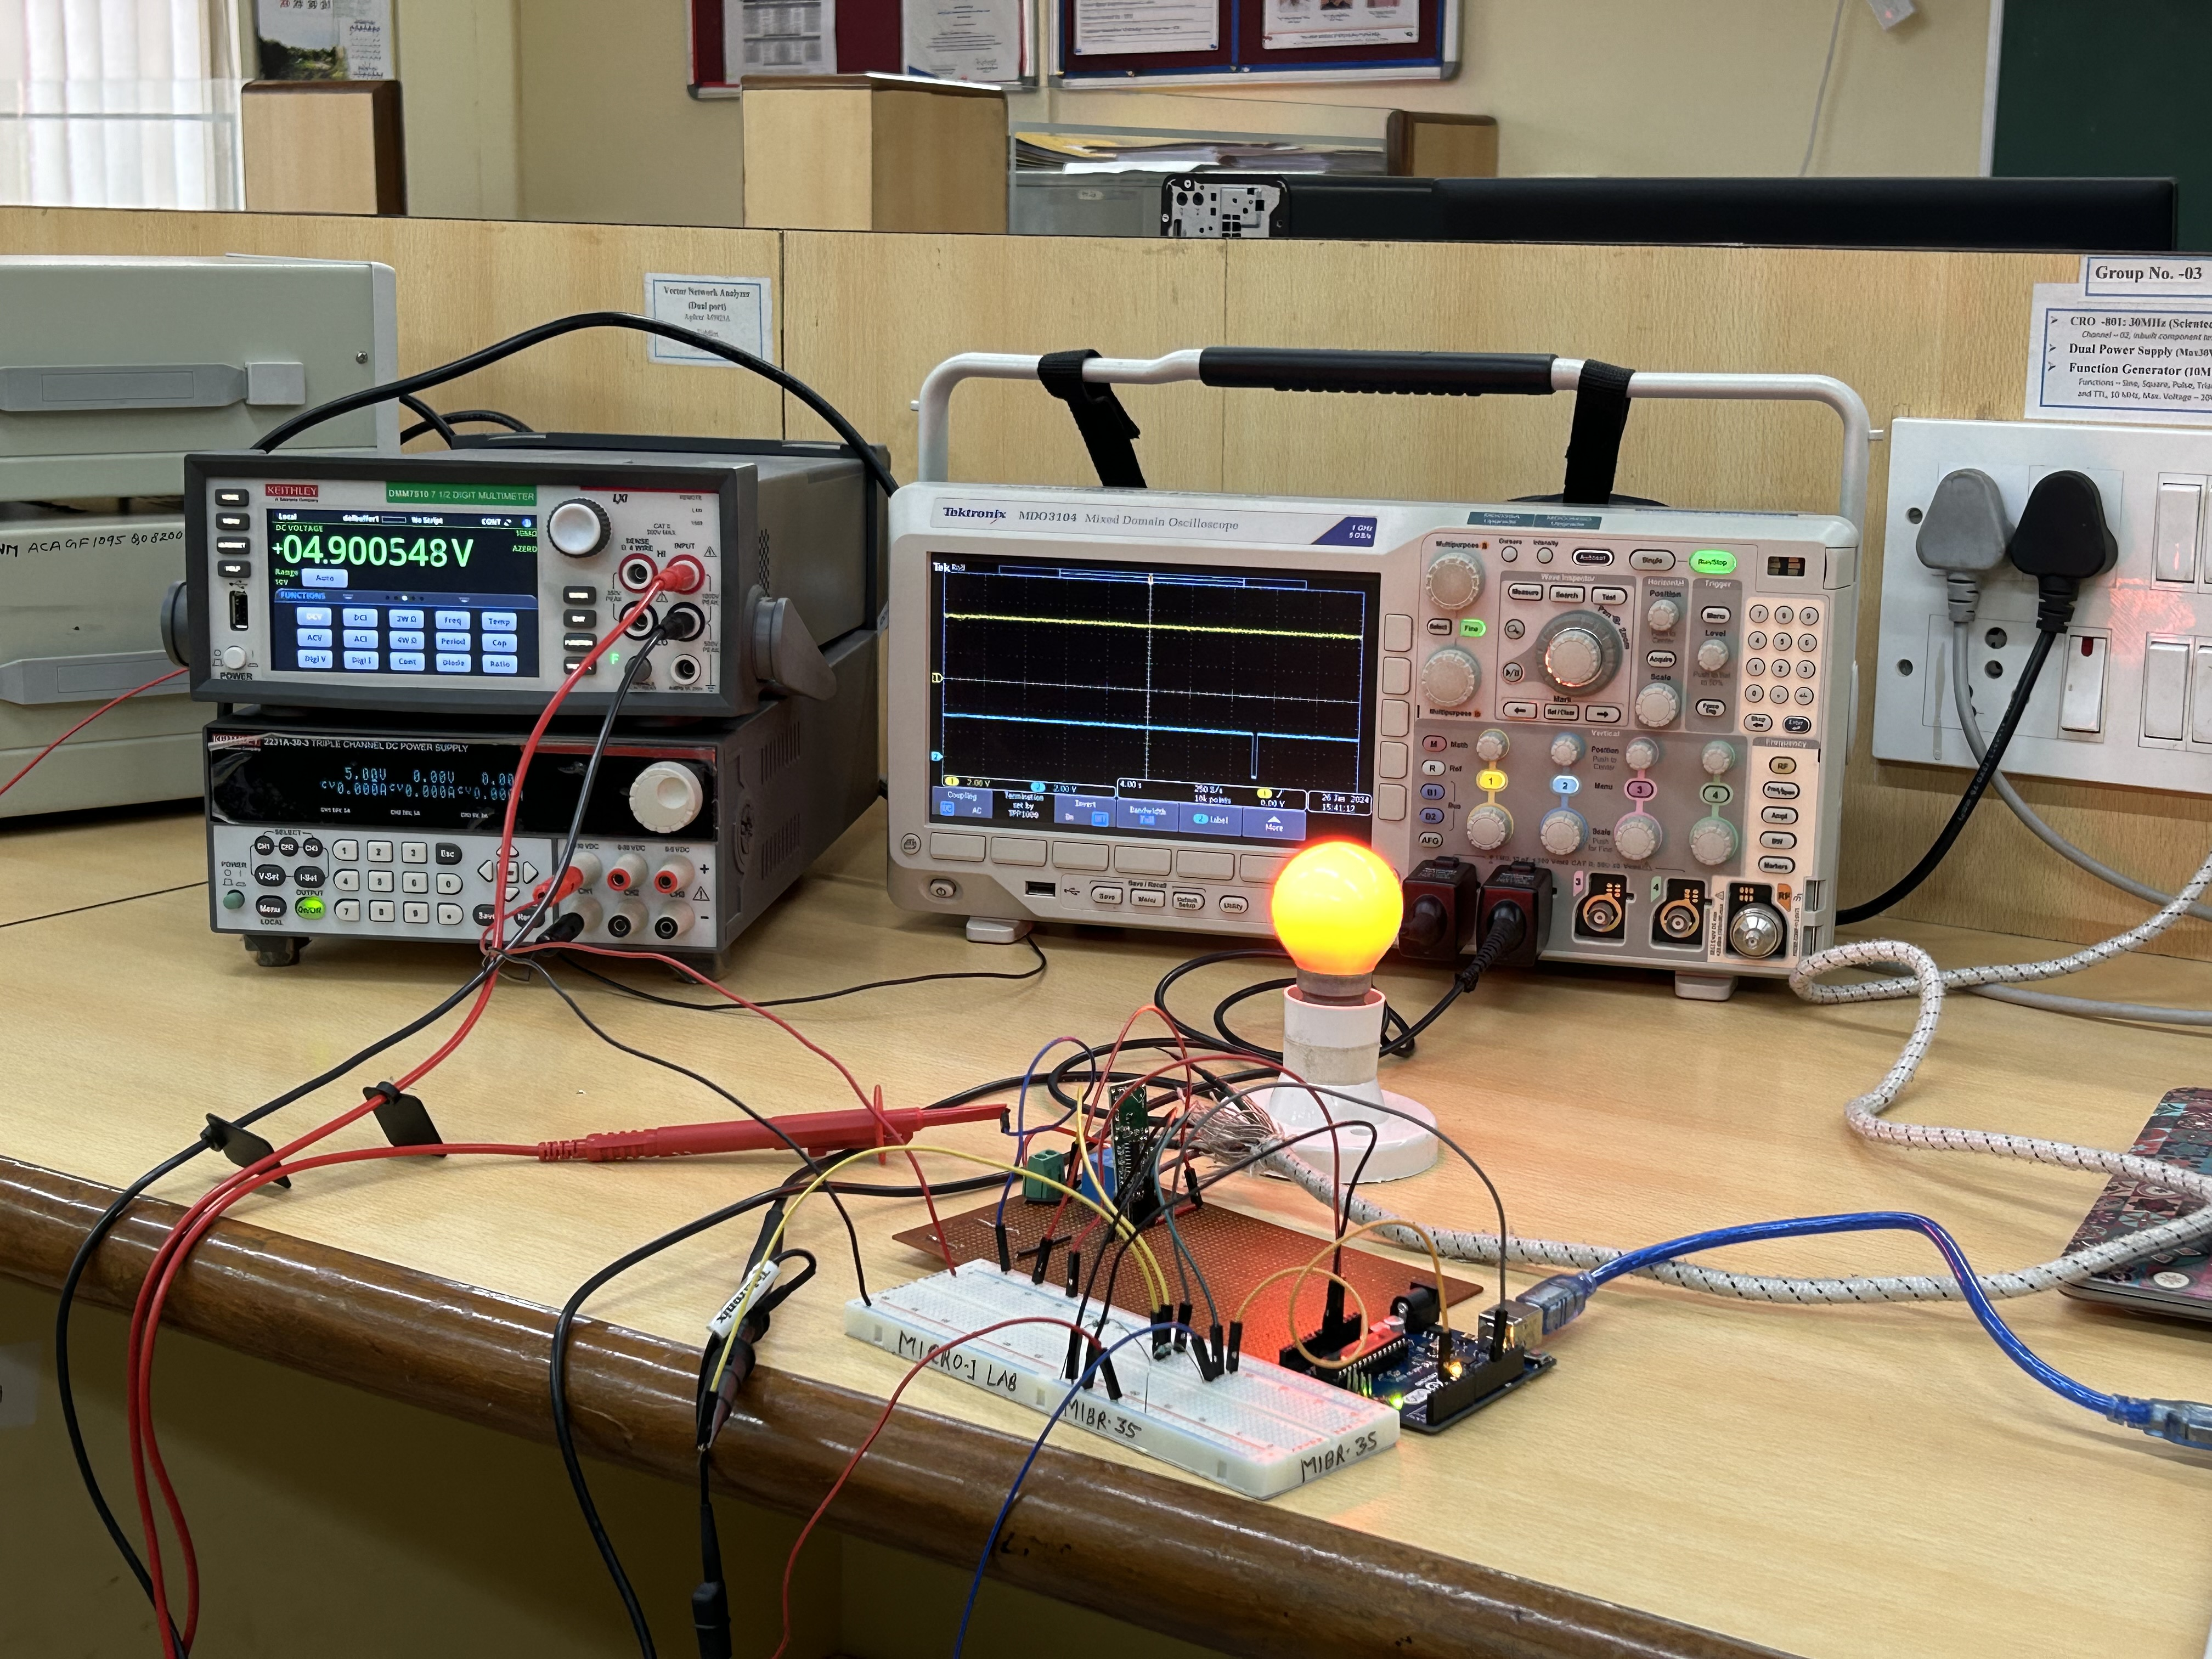
2nd Prototype-26/01/24

Slide 39
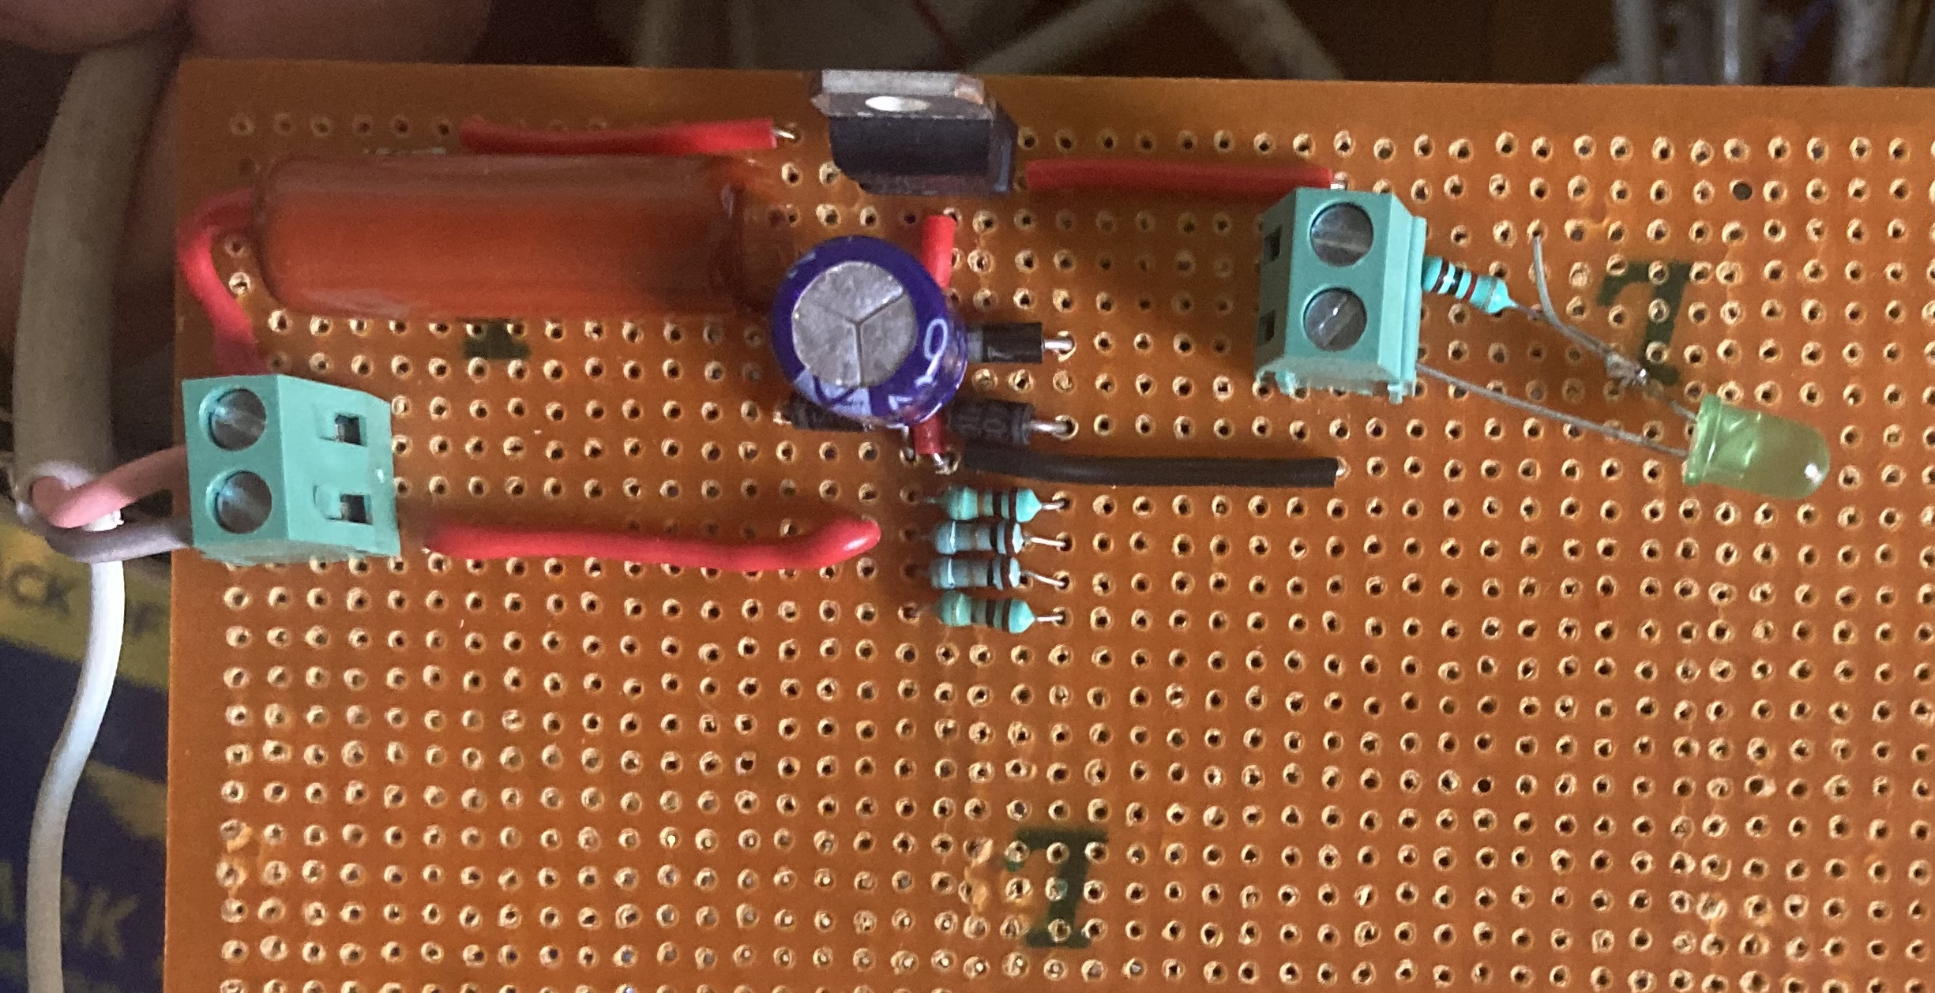
Transformerless Power Supply

Slide 40
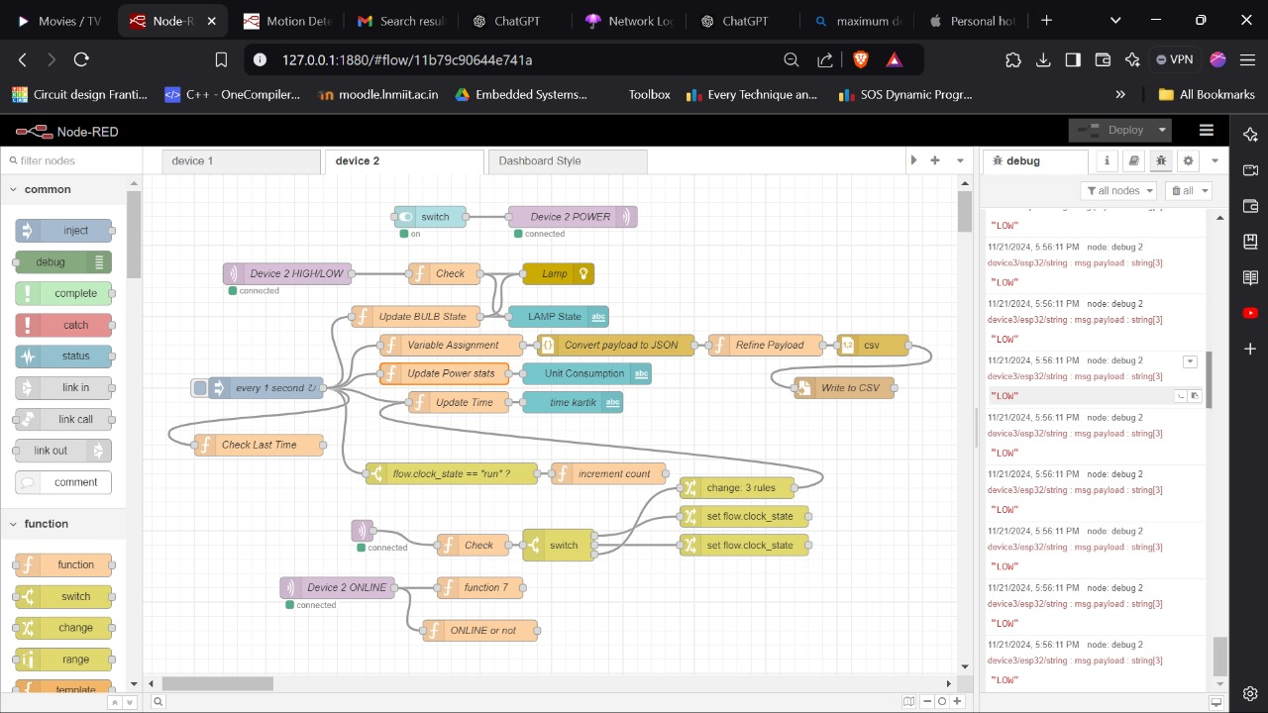
Node-RED flow

